Slide 1
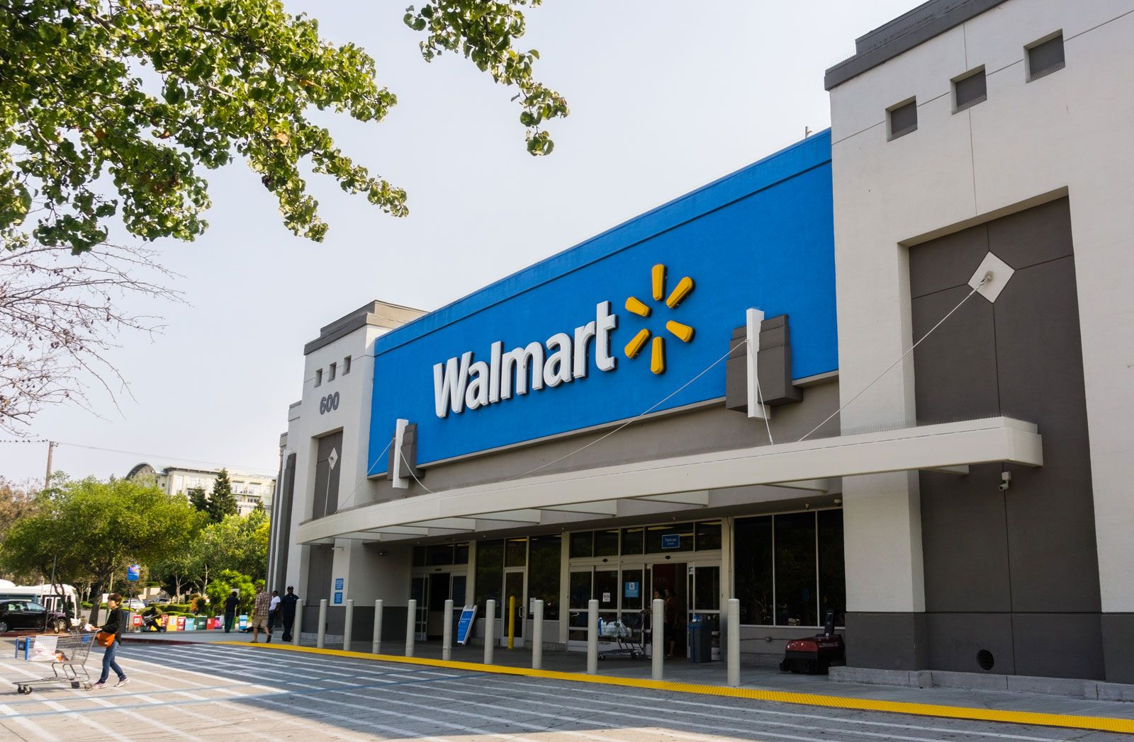
MT140: Introduction to Management Desmond Hughes Walmart INC.
1

Slide 2
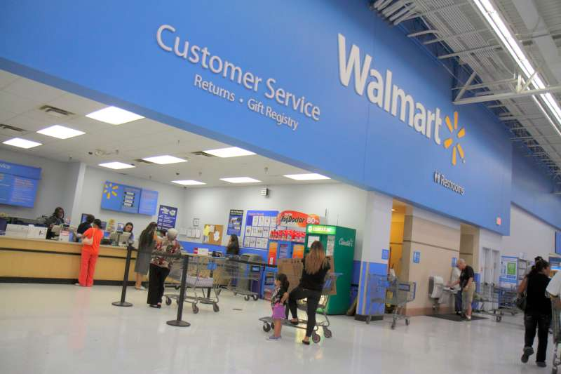
POLC
Planning: Setting Goals and setting your course of action
Organizing: Adding structure and making decisions
Leading: Influences that will inspire employees.
Controlling: making sure standards are being meet and taking action to correct steps if needed.
What is POLC?
2

Slide 3

Company Overview Mission Statement Vision Statement Values of the Company
Mission Statement
Vision Statement
Values of the Company
“Save people money so they can live better” (Statements, 2022) is Walmart's mission statement. They try and give the customers the best prices, so they are satisfied.
“Be the destination for customer to save money, no matter how they want to shop” (Statements, 2022)Walmart tries to make items Affordable and have them so they can be convenient for the customers.
The culture and customer's are the foundation of Walmart. That’s why they try to always try to improve customer service and try saving people money. To “Strive for excellence, Act with integrity” ("Walmart Core Values | Walmart Careers", 2022)
3

Slide 4
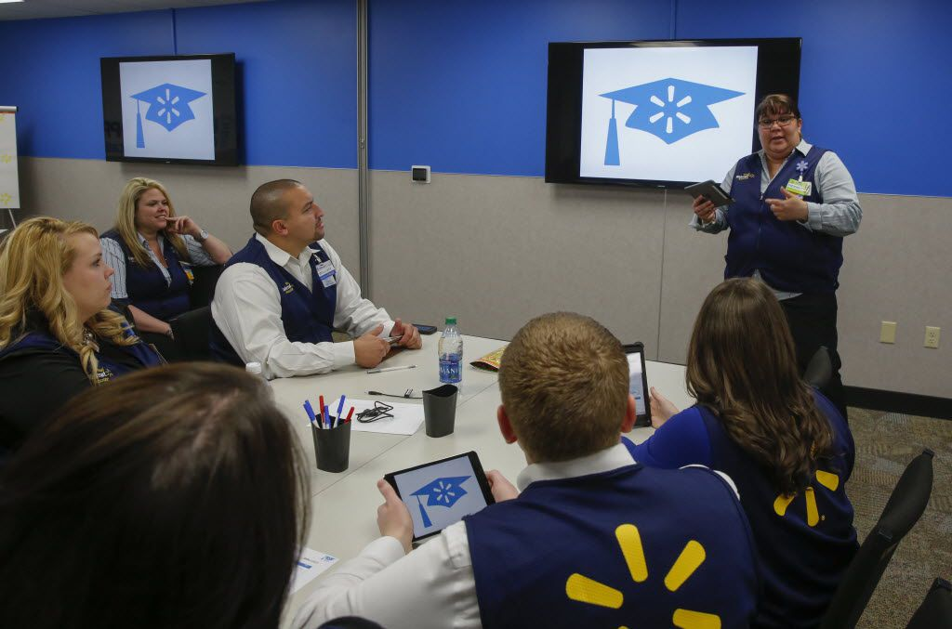
Strategic Planning (Goal, Manager & Power)
Their Strategic Planning is to move with speed and at the same time connect more with the customers, and saving the customers time and money by having a variety of things for a low price. By doing this they try to dominate the market.
McMillion said “We’re equipping out associates with training and technology so they will continue to innovate in our stores, clubs and through eCommerce to find ways to deliver an enjoyable shopping experience for our customers that is easy, fast, friendly and fun/” ("planning", 2022)
4

Slide 5
Tactical Planning (Goal, Manager & Power)
For tactical goals Walmart plans to focus on major actions that the division must take to fulfill its part in the strategic plan that is determined by managers.
They also use promotion for items and move items to make it easier for the customers to shop and focus on demands

Slide 6
Operational Planning (Goal, Manager & Power)
For the operational planning Walmart focuses on the lower levels, like different departments in the store and their workers.
Managers come up with tasks to help with tactical and strategic goals by focusing on the customer’s satisfaction
They try to improve the customers shopping experience

Slide 7
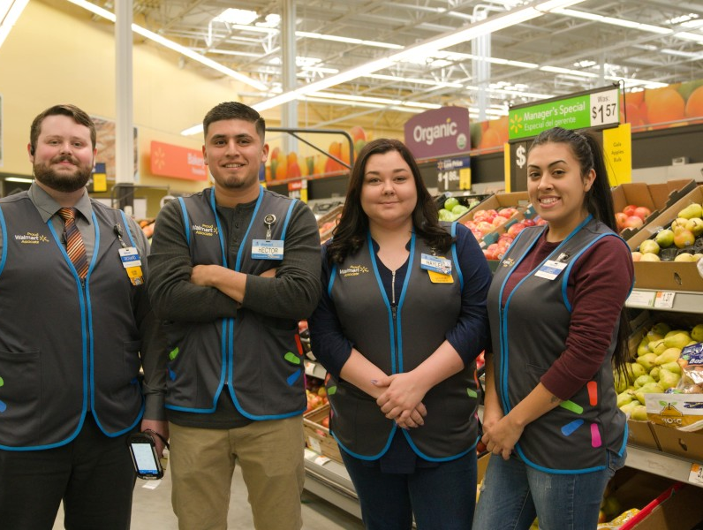
Bureaucratic Control
Bureaucratic control allows Walmart to efficiently and quickly serve customers with great prices
Walmart follows up productivity with reports, monitoring, and evaluating the employee's work ethic, and effectiveness
5

Slide 8
References
Bateman, T. S., Snell, S., & Konopaske, R. (2020). Management. McGraw-Hill Education.
planning. (2022). Retrieved 23 May 2022, from https://walmartmanagementwalmart2014.wordpress.com/planning/
Statements, M. (2022). Walmart Mission Statement 2022 | Walmart Mission & Vision Analysis. Retrieved 23 May 2022, from https://mission-statement.com/walmart/#:~:text=Walmart's%20vision%20statement%20is%20%E2%80%9CBe,itself%20as%20the%20retail%20leader.
Walmart Core Values | Walmart Careers. (2022). Retrieved 23 May 2022, from https://careers.walmart.com/values

Slide 9
Picture References
1:Walmart | History & Facts. (2022). Retrieved 23 May 2022, from https://www.britannica.com/topic/Walmart
2:Returning Unwanted Holiday Gifts: The Essential Guide. (2022). Retrieved 23 May 2022, from https://money.com/return-policy-holiday-gifts-walmart-target-amazon/
3: Ko, W., Ko, W., & profile, V. (2022). The Successful Cost Leadership Strategy of WalMart. Retrieved 23 May 2022, from http://winaungko.blogspot.com/2011/10/successful-cost-leadership-strategy-of.html
4: (2022). Retrieved 23 May 2022, from https://www.dallasnews.com/business/retail/2021/06/09/walmart-offers-classes-to-the-public-to-help-increase-upward-mobility/
5: Walmart Newsroom. (2022). Retrieved 23 May 2022, from https://corporate.walmart.com/newsroom/2019/10/30/customers-are-changing-jobs-are-changing-at-walmart-the-future-of-work-is-bright

